Slide 1
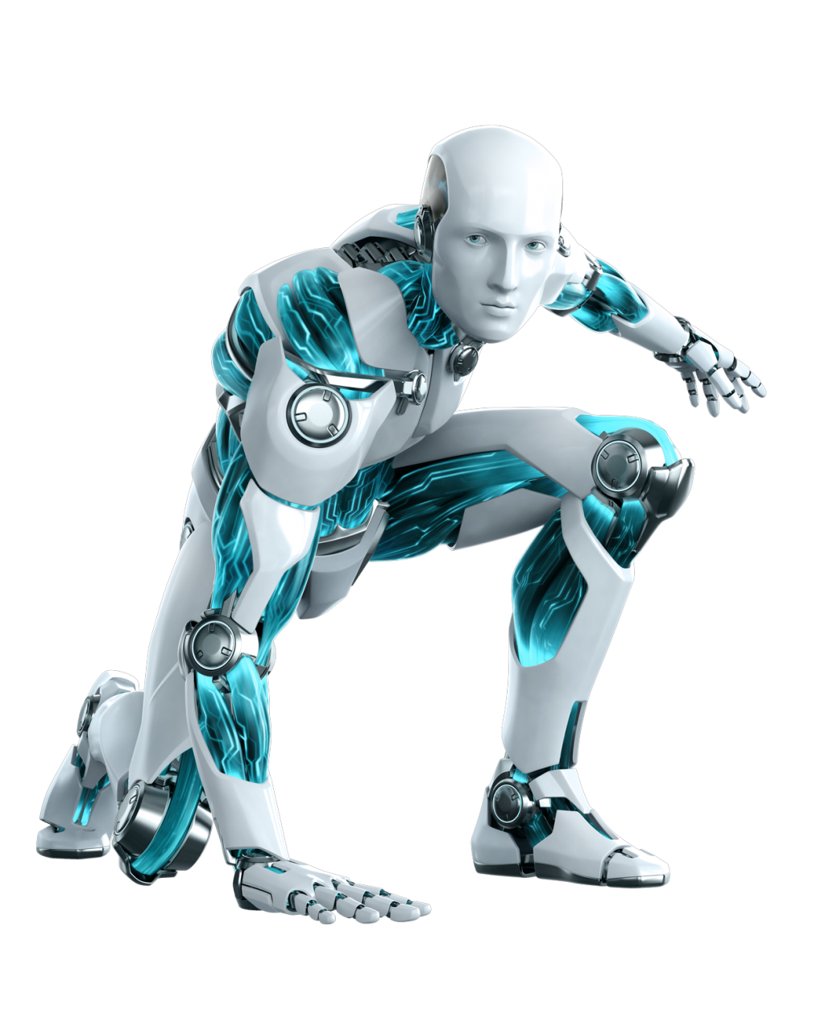
Duration: 120 min
Chungnam University
Graduate class
Remote Sensing
Getting started with Ollama, Chatbox, and system prompts
September 10th 2025
By the end of this lecture you should be able to:
Explain what AI and LLMs are.
Understand base vs fine-tuned models.
Explain why LoRA/QLoRA are efficient.
Describe RAG in simple terms.
Use system prompts to change AI personality.
Run your first LLM locally on your computer.

Slide 2
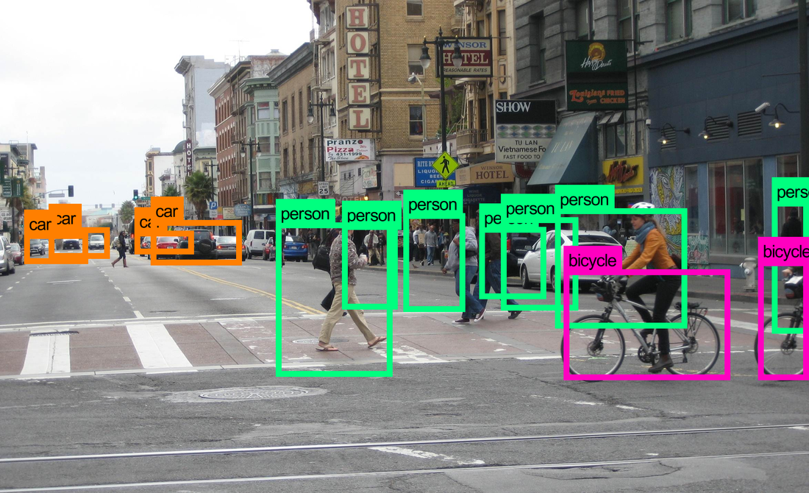
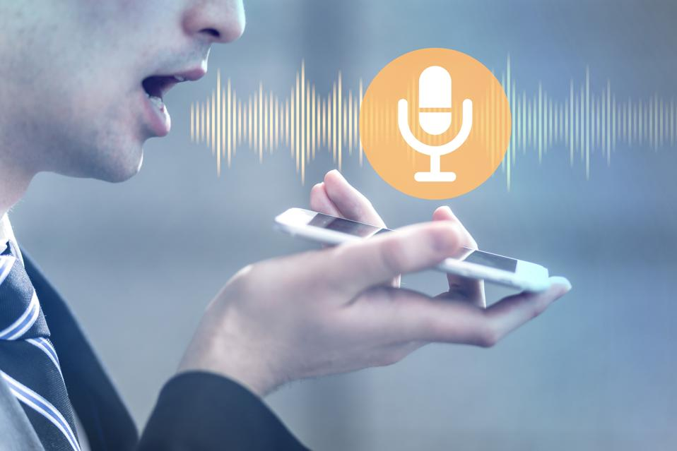
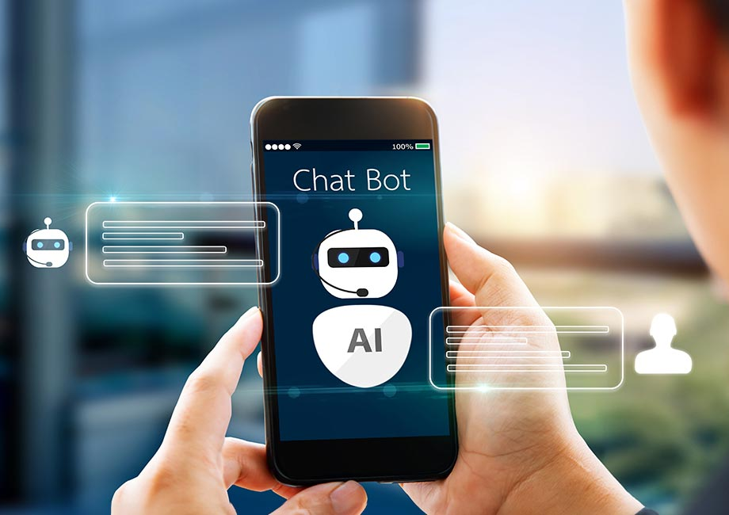
What is AI ?
AI (Artificial Intelligence) = when a computer program is designed to act “intelligently,” like a human.
Instead of following exact instructions (traditional programming), AI learns patterns from data.
Hear?
Talk?
See?

Slide 3
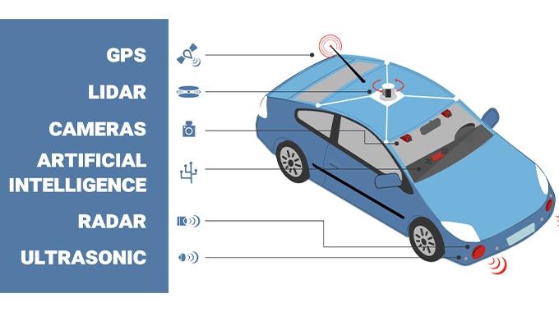
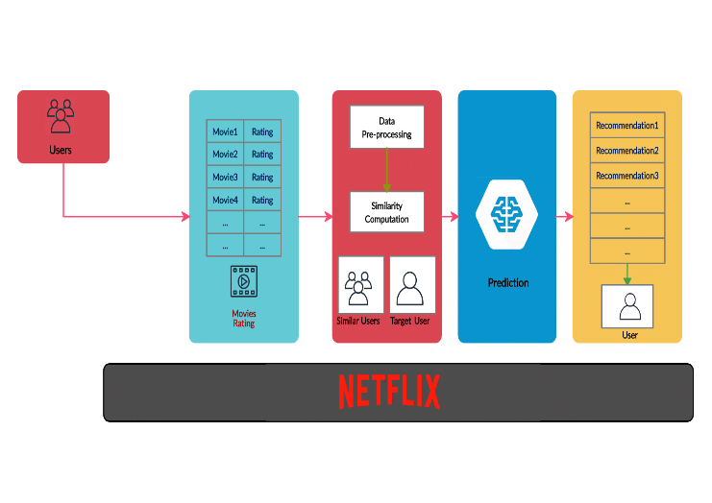
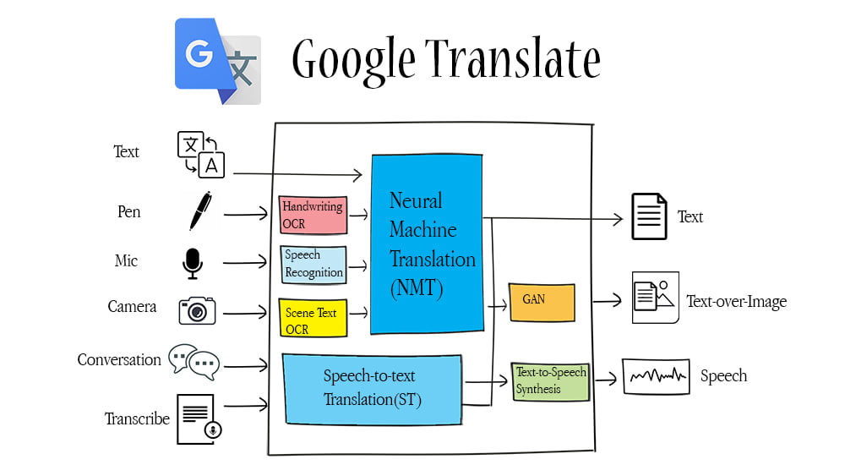
Everyday Examples
Netflix / YouTube recommendations → AI predicts what you like.
Google Translate → AI understands language patterns.
Self-driving cars → AI processes camera images to make driving decisions.
So AI is the “big idea”: machines that can think, learn, and adapt instead of only following hard-coded rules.

Slide 4
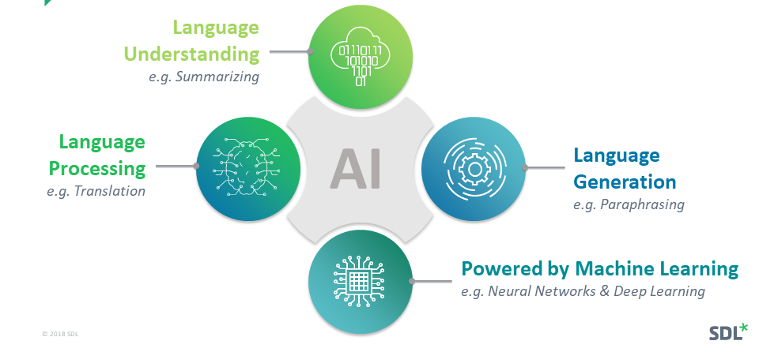
Linguistic AI
Language AI is a branch of artificial intelligence that focuses on enabling computers to understand, process, and generate human language, both spoken and written.
In our course, we focus on Language AI → AI that reads, writes, and answers text.

Slide 5
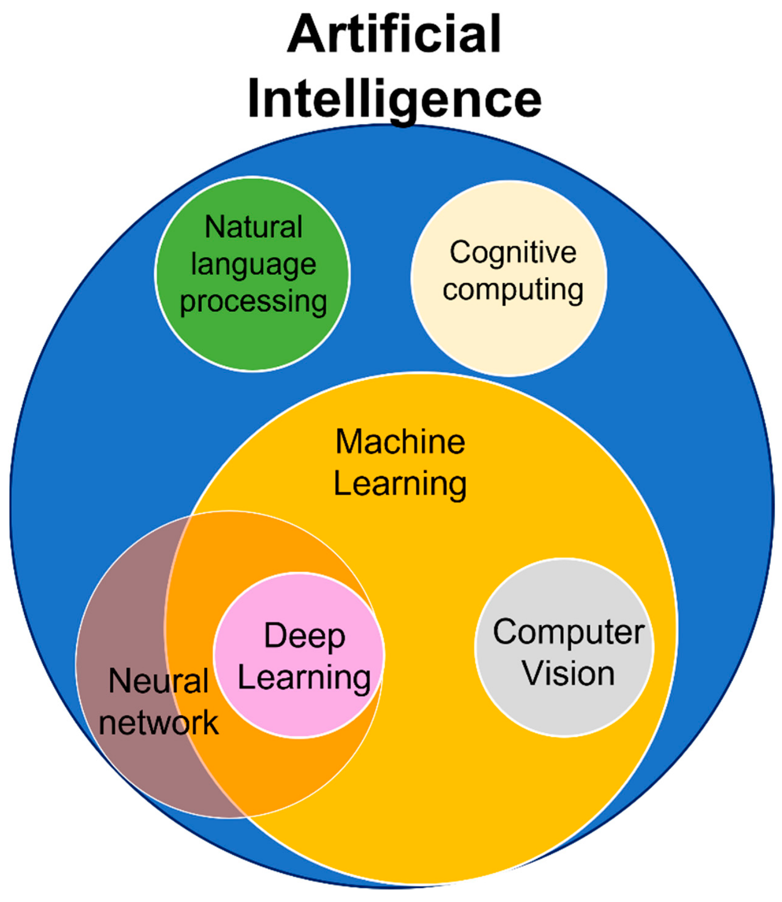
The structure of AI
AI (Artificial Intelligence): The umbrella term.
Any machine that acts “intelligent.”
Includes chess-playing computers, recommendation systems, image recognition, etc.
Machine Learning (ML): A branch of AI.
Instead of rules, the machine learns from examples.
Example: Show an ML model 10,000 cat and dog pictures → it learns to classify new ones.
Deep Learning (DL): A sub-branch of ML.
Uses neural networks inspired by how the human brain works.
Many “layers” of neurons process information step by step.
Example: Voice assistants (like Siri) use deep learning to convert speech into text.
Large Language Models (LLMs): A special type of deep learning.
Focus only on language (reading, writing, summarizing, translating).
Examples: ChatGPT, LLaMA, DeepSeek, Mistral.

Slide 6
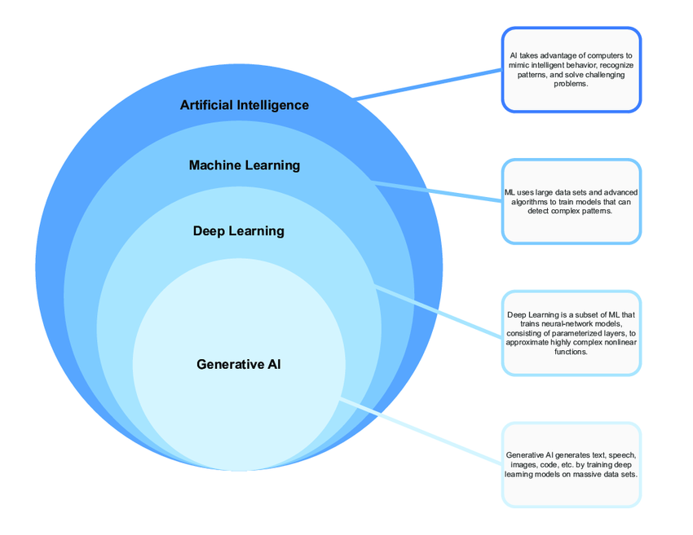
What is Generative AI?
GenAI is a type of Artificial Intelligence that creates new content based on what it has learned from existing content.
The process of learning from existing content is called training and results in the creation of a statistical model.
When given a prompt, GenAI uses this statistical model to predict what an expected response might be–and this generates new content.
It learns the underlying structure of the data and can then generate new samples that are similar to the data it was trained on.

Slide 7
Model types available to us
Text to text
Takes a natural language input and produce text output.
Trained to learn the mapping between a pair of texts
Text to image
Trained on a large set of images, each captioned with a short text description
Text to video
Generate a video representation from text input
Text to task
Trained to perform a defined task or action based on text input.
Such as answering a question, performing a search, making a prediction

Slide 8
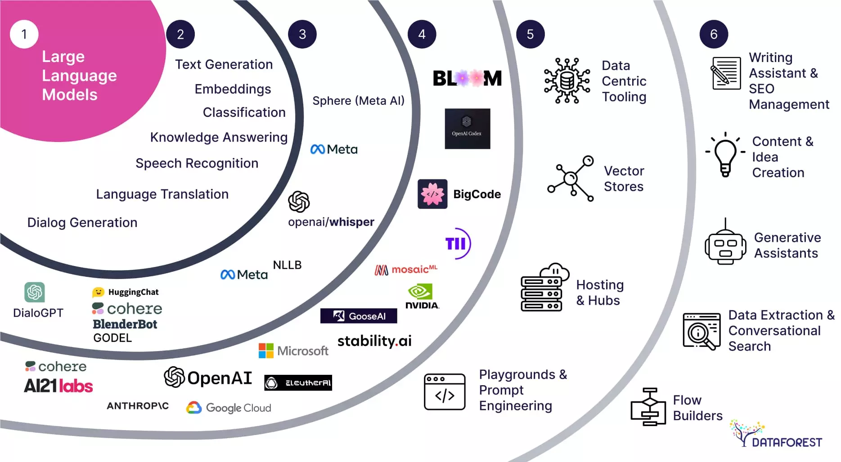
Large Language Model (LLM)?
An LLM is a deep learning model trained on huge amounts of text (books, websites, articles, code).
Main task: predict the next word (token) in a sentence.
Because it has seen so much text, it can:
1. Answer questions
2. Write essays
3. Generate code
4. Summarize documents
The largest and most capable LLMs are generative pre-trained transformers (GPTs), based on a transformer architecture, which are largely used in generative chatbots such as ChatGPT, Gemini and Claude. LLMs can be fine-tuned for specific tasks or guided by prompt engineering.

Slide 9
Key Concepts: Token
Token:
The basic unit of text for LLMs.
Usually a word or part of a word.
Example: The sentence
“Sericite is a fine-grained mica.” →
Models process tokens, not whole sentences at once.
["Ser", "icite", " is", " a", " fine", "-", "grained", " mica", "."]
How Does Tokenization Work?
Automatic → You don’t split tokens yourself.
Each LLM comes with its own tokenizer (a built-in algorithm that decides how to split text).
The tokenizer maps text → numbers (because models only understand numbers).
Example: Word “mica” → Token ID 5023 (just an example number).
Token Length & Limits
Every LLM has a context window = max tokens it can read at once.
Example:
LLaMA3-8B → 8,000 tokens.
GPT-4o → 128,000 tokens.
1 token ≈ ~4 characters in English (~¾ of a word). So 1,000 tokens ≈ 750 words.

Slide 10

Key Concepts: Parameters
Parameters = the internal “knobs” or “weights” inside the neural network.
Each parameter is just a number (usually a decimal like 0.1234 or -0.8765).
During training, the model adjusts these numbers to better predict the next word.
→ Think of parameters as memory of what the model learned from data.
An LLM is built from layers of neurons (mathematical functions).
Each neuron has connections to the next layer.
Each connection has a weight → that weight is a parameter.
Training = adjusting these weights until the network gets good at language.
Why So Many Parameters?
Small models → ~100 million parameters.
Big models → tens or hundreds of billions of parameters.
Examples:
GPT-2 → 1.5B parameters.
LLaMA 3 (8B) → 8 billion parameters.
LLaMA 3 (70B) → 70 billion parameters.
GPT-4 → rumored to have trillions of parameters (not disclosed).

Slide 11
Key Concepts: Parameters vs Tokens
Tokens = input/output pieces (what the model reads and writes).
Parameters = the model’s memory (what it knows from training).
Tokens = words you say in conversation.
Parameters = your brain’s knowledge that lets you form those words.
Parameters = the learned weights in the neural network.
They store everything the model knows.
Billions of parameters = rich memory of grammar, facts, style, logic.
During training, parameters are adjusted millions of times.
Tokens = input/output → Parameters = memory/knowledge.

Slide 12







Famous Modern LLMs (2024 – 2025)
OpenAI GPT-4 / GPT-4o
Commercial model (used in ChatGPT).
Strong at reasoning, coding, writing.
Not open source.
Google Gemini (Ultra, Pro, Nano)
Google’s flagship AI.
Multimodal (can handle text, images, audio).
Competes with GPT.
Meta LLaMA 3
Open-source (free to download and run).
Available in sizes: 8B, 70B.
Very popular for research & customization.
Google Gemma
Lightweight, open-source LLM.
Smaller than LLaMA, designed for fine-tuning.
Anthropic Claude
Commercial (like GPT).
Focus on safety and reliability.
Mistral / Mixtral
Open-source, highly efficient.
Mixtral = “mixture of experts,” uses only part of the model at once → faster.
DeepSeek (China)
Released by a Chinese research team.
Open-source, designed to be efficient and strong at reasoning.
Often competitive with GPT and LLaMA in benchmarks.
Different versions (chat models, coding-focused models).
Gaining popularity in Asia for open research and cost-effectiveness.

Slide 13
What matters when training LLMs
Architecture
Training algorithm/ loss
Data
Evaluation
Systems
Academic focus
Industry focus

Slide 14
Base Model
Definition:
A base model is the raw version of an LLM trained on a very large, general dataset (internet text, books, Wikipedia, code, etc.).
It has broad knowledge but no task-specific expertise.
How it works:
Trained once, usually by big research labs (Meta, OpenAI, Google).
Extremely expensive to create → requires huge GPUs and billions of tokens.
Example:
LLaMA 3 (8B, 70B) as released by Meta → a general-purpose base model.
Knows science, history, math, language, but not specialized in geology or medicine.

Slide 15
Fine-Tuning
Definition:
The process of training a base model on new, specialized data.
How it works:
Expose the model to thousands of examples (Q&A, reports, documents).
Adjust some or all parameters so it adapts to the task.
Can be “full fine-tuning” (expensive) or “parameter-efficient fine-tuning” (cheap).
Analogy:
Teaching a general doctor to specialize by giving them years of medical cases in cardiology.
Example:
Fine-tuning LLaMA on legal documents → becomes a legal assistant.
Fine-tuning LLaMA on Korean geology datasets → becomes a geology assistant.

Slide 16
Fine-Tuning Types
A. Full Fine-Tuning
What it is: Update all parameters of the model.
Pros: Very powerful → model can deeply adapt.
Cons: Extremely expensive (needs supercomputers).
Analogy: Rewriting an entire textbook.
Example: OpenAI or Google updating GPT/Gemini with massive new datasets.
B. Parameter-Efficient Fine-Tuning (PEFT)
What it is: Update only a small fraction of the parameters.
Pros: Much cheaper, works on normal GPUs.
Cons: Less flexible than full fine-tuning, but usually “good enough.”
Analogy: Instead of rewriting the textbook, you add sticky notes or highlight important pages.
Example: Research labs adapting LLaMA for medicine, law, geology, etc.
Key Insight:
Full fine-tuning = best accuracy but unrealistic for students/researchers.
PEFT = the practical choice for adapting big models.

Slide 17
Parameter-Efficient Fine-Tuning (PEFT)
LoRA (Low-Rank Adaptation)
Type: A popular PEFT method.
How it works:
Freeze the base model.
Insert small “adapter layers.”
Train only these adapters (very small compared to full model).
Analogy: Adding sticky notes in a textbook → quick and efficient.
Example: Adding a geology adapter to LLaMA → it answers better about rocks and minerals.
QLoRA (Quantized LoRA)
Definition: A more memory-efficient version of LoRA.
How it works: Compress the model into smaller numbers (quantization) + train adapters.
Result: You can fine-tune very large models (like 70B parameters) on a single GPU.
Analogy: Sticky notes in shorthand → smaller, but still useful.
Example: Fine-tuning a giant model like LLaMA-70B on a consumer GPU.

Slide 18
Parameter-Efficient Fine-Tuning (PEFT)
Feature | LoRA | QLoRA
Base Model Precision | Full precision (16-bit FP or bfloat16). | Quantized (compressed to 4-bit or 8-bit).
Memory Usage | Higher (needs more GPU VRAM). | Much lower (can run 33B–70B models on consumer GPUs).
Hardware Needs | Requires powerful GPUs (e.g., A100, 3090, 4090). | Can run on smaller GPUs (even laptop GPUs with 8–16GB VRAM).
Training Speed | Faster than full fine-tuning but still heavy for large models. | Slightly slower due to quantization overhead but allows much larger models.
Accuracy | High (close to full fine-tuning). | Almost the same as LoRA; small drop in rare cases.
Use Case | Fine-tuning medium-size models (7B–13B). | Fine-tuning large models (33B–70B) on normal hardware.
Analogy | Sticky notes in the full textbook. | Sticky notes in a compressed photocopy of the textbook.

Slide 19
Which is better? LoRA or Qlora?
1. Accuracy
LoRA:
Uses the base model in full precision (16-bit or bfloat16).
Fine-tuning updates adapters with high accuracy.
Usually slightly more accurate than QLoRA.
QLoRA:
Compresses (quantizes) the base model into 4-bit or 8-bit numbers.
Adapters still train well, but small precision loss may occur.
In most real-world benchmarks, QLoRA accuracy ≈ LoRA accuracy (within 1–2%).
2. Hardware Efficiency
LoRA:
Needs more GPU memory → not practical for huge models.
Example: Fine-tuning LLaMA 70B with LoRA needs 8×A100 GPUs.
QLoRA:
Can fine-tune massive models on a single GPU (24–48GB VRAM).
Example: LLaMA 70B fine-tuned on a single GPU using QLoRA.

Slide 20
Fine-Tuned Model
Definition:
A fine-tuned model is a base model that has been trained further on specialized data for a specific task or domain.
How it works:
Start with the base model’s weights (parameters).
Train only a bit more, using domain data (e.g., medical text, legal contracts, geology papers).
The result: model keeps its general knowledge but performs better in the specific domain.
Analogy:
A medical student (base) who goes through residency in cardiology → becomes a heart specialist.
Example:
A LLaMA base model fine-tuned on geology textbooks + field reports → becomes better at answering geology questions than the base model.
OpenAI’s GPT-3.5-turbo fine-tuned for customer support → answers faster and more politely.

Slide 21
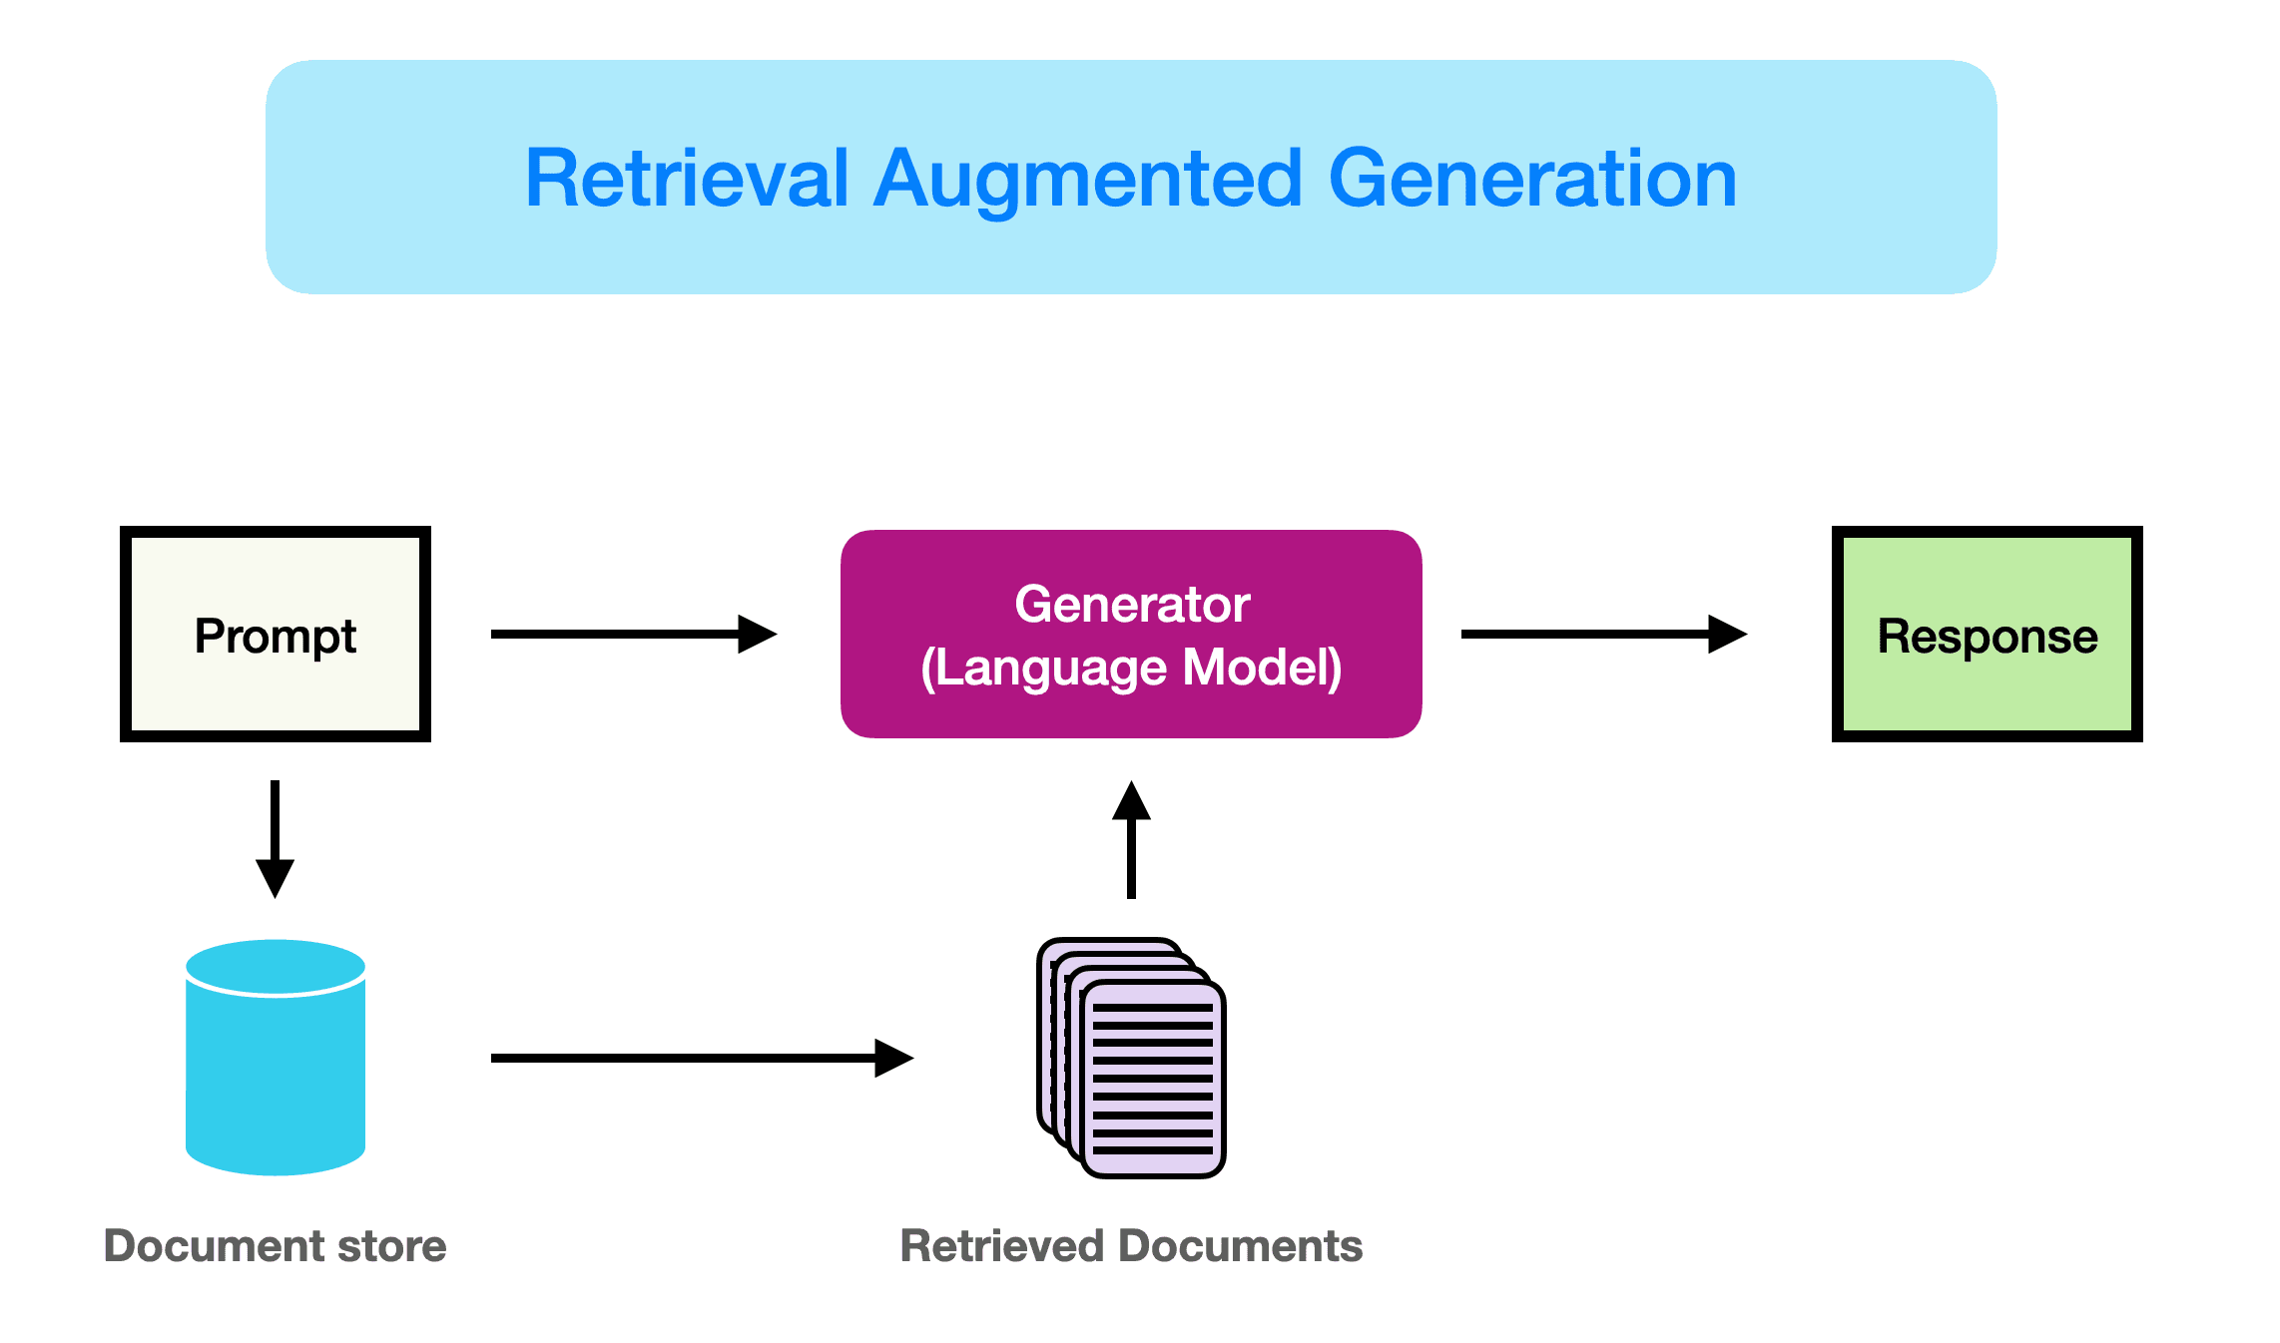
RAG (Retrieval-Augmented Generation)
Problem: LLMs have a knowledge cut-off (e.g., trained until 2023) and don’t know your personal files.
Solution: Instead of re-training, let the model retrieve external documents during a conversation.
How it works:
Store PDFs/reports in a searchable database.
When asked, system retrieves the most relevant chunks.
Model uses both its internal knowledge + external docs to answer.
Analogy: Open-book exam → model looks up the right page instead of memorizing everything.

Slide 22
System Prompts
A system prompt (also called a system instruction) is the very first hidden instruction given to the model before the user types anything.
It defines:
The role of the AI (teacher, assistant, coder, etc.).
The tone (formal, casual, supportive, strict).
The rules (what it should/shouldn’t do).
→ Without a system prompt, the model just behaves as a generic assistant. → With a system prompt, you can shape its personality and behavior.
Imagine a conversation in Chatbox (or ChatGPT):
System prompt (hidden):
“You are a geology professor. Explain things step by step and use examples.”
User prompt:
“What is sericite?”
Model output:
“Sericite is a fine-grained mica mineral. Let me break it down step by step…”
The model always reads the system prompt first, so all answers are influenced by it.

Slide 23
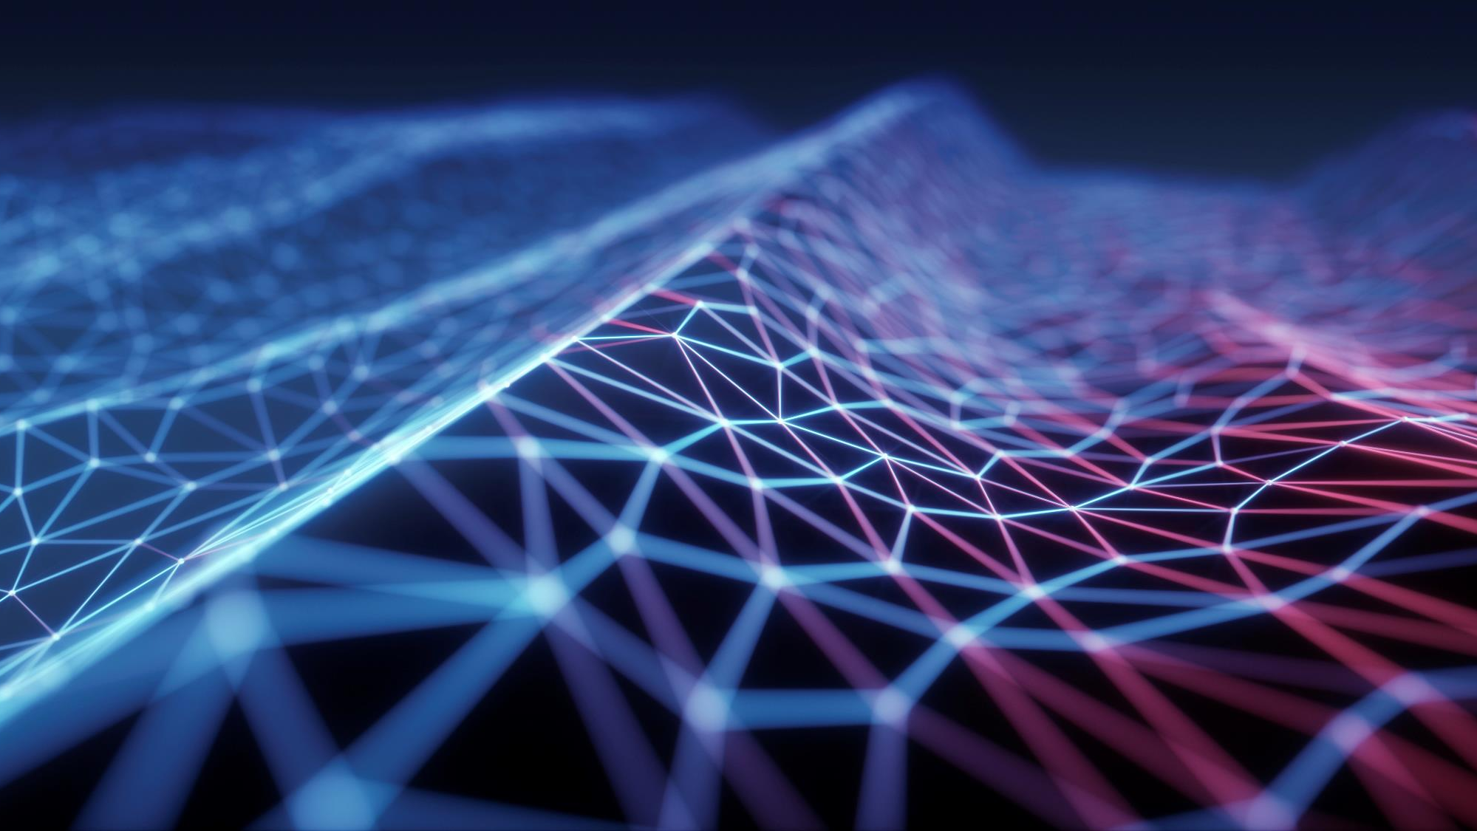
QUICK GUILD TO START
2025.09.10

Slide 24
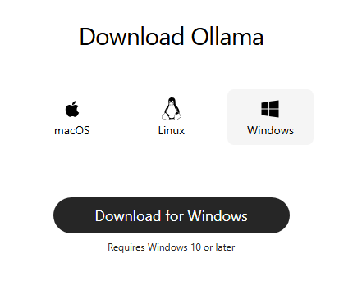
1. Install ollama
Enter this link: https://ollama.com/
Click download and install

Slide 25
2. USE A SYMBOLIC LINK
Since Ollama installed on C drive, so pull/download a pre-trained model will store in C → Heavy windows system
1. Move your existing .ollama\models folder to your new location (E:\AI_Assist_model)
2. Delete the original
<cmd>
robocopy "C:\Users\HUYHOA-REMOTESENSING\.ollama\models" "E:\AI_Assist_model" /MIR
3. Symbolic Link
rmdir /S /Q "C:\Users\HUYHOA-REMOTESENSING\.ollama\models"
<cmd with Run As Admin>
mklink /D "C:\Users\HUYHOA-REMOTESENSING\.ollama\models" "E:\AI_Assist_model”
mklink /D "C:\Users\RS02\.ollama\models" "D:\Hoa_progress\AI_Deep_learning"

Slide 26
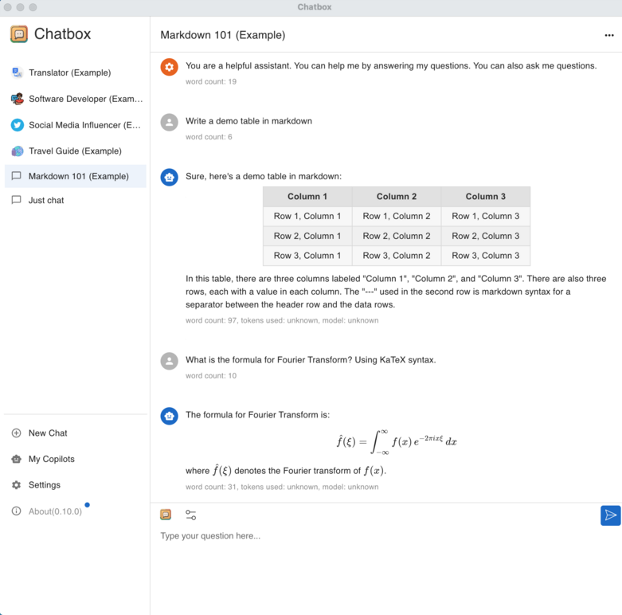
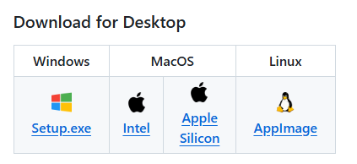
3. Install gui (Chatbox)
Recommendation: https://github.com/chatboxai/chatbox
Get started quickly with downloadable installation packages. No complex setup necessary!
Support for Multiple models: OpenAI, Claude, Gemini,…
Enhanced Prompting

Slide 27
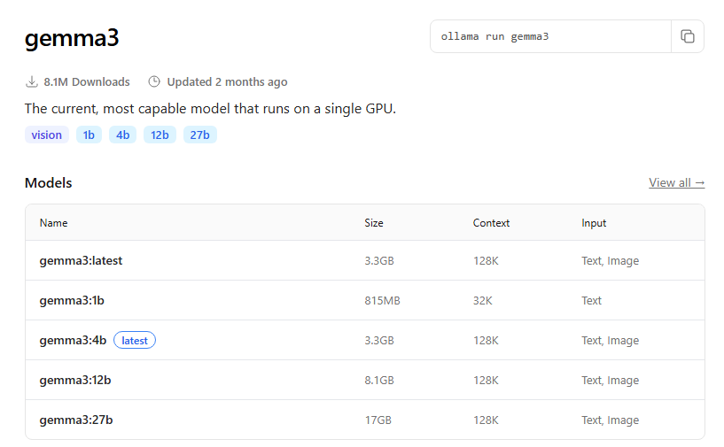
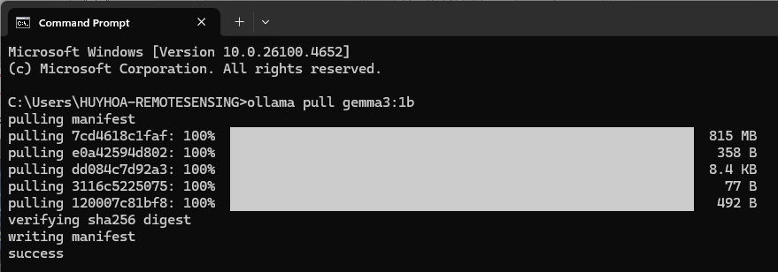
4. DOWNLOAD THE DEEP LEARNING AI MODELS
Open Command Prompt (cmd).
Type: ollama pull model
You can search for any AI models from Ollama library: https://ollama.com/library
For example, I want to download “gemma3:1b” model → ollama pull gemma3:1b

Slide 28
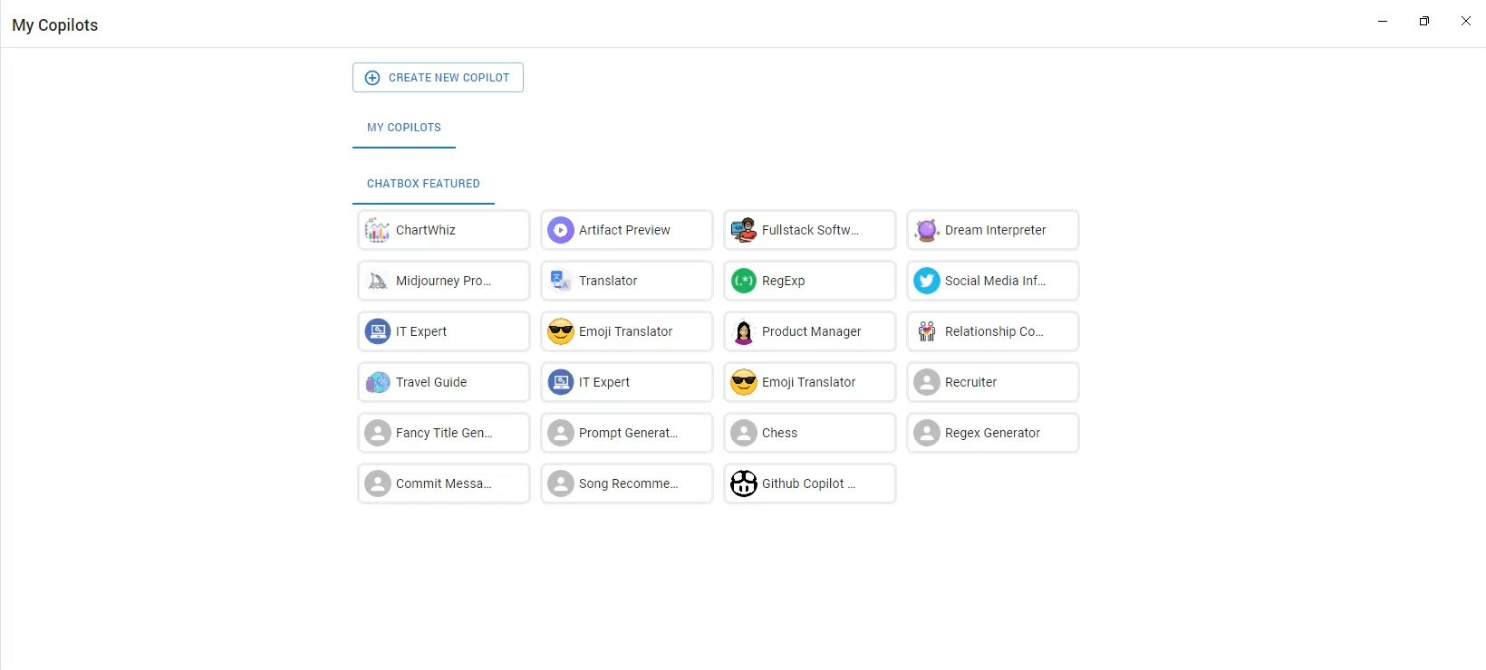
5. Testing the models with chatbox
Open Chatbox
Click Setting → Select Ollama → Fetch
Select the downloaded models

Slide 29
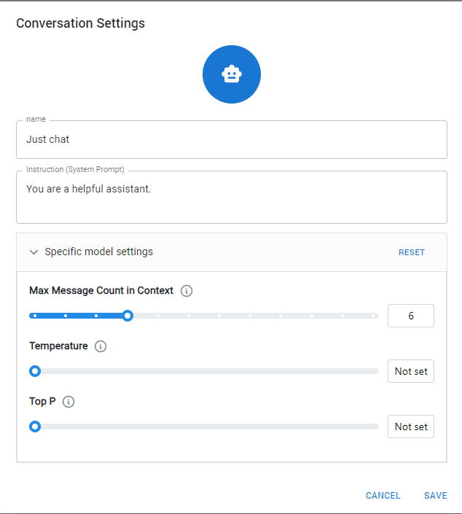
6. Understand system prompt
In chat-based large-language-model (LLM) APIs (OpenAI, Anthropic, Google, etc.), every conversation starts with one or more system messages.
They set the rules of the game: role, tone, priorities, omissions, safety constraints, formatting, etc.
They have higher priority than the user’s messages—if the system prompt says “never mention politics,” the model will comply even if the user later asks about it.
They are invisible to end-users unless you choose to expose them (ChatGPT shows you the “system” line only in the advanced settings).
Think of a system prompt as the constitution; user prompts are the laws; assistant responses are the court decisions that must obey the hierarchy.

Slide 30
Week 2 assignment – getting started with ai models
Part 1: Environment Setup
Download and install:
Ollama: https://ollama.com
Chatbox: https://chatboxapp.xyz
Part 2: System Prompt Experiment
Research online for examples of system prompts.
1. Modify system prompts to improve model responses.
2. Choose one question (e.g., “Explain hyperspectral imaging in remote sensing”) and test it with different system prompts (e.g., teacher, reviewer, friendly).
Record how the answers change.

Slide 31
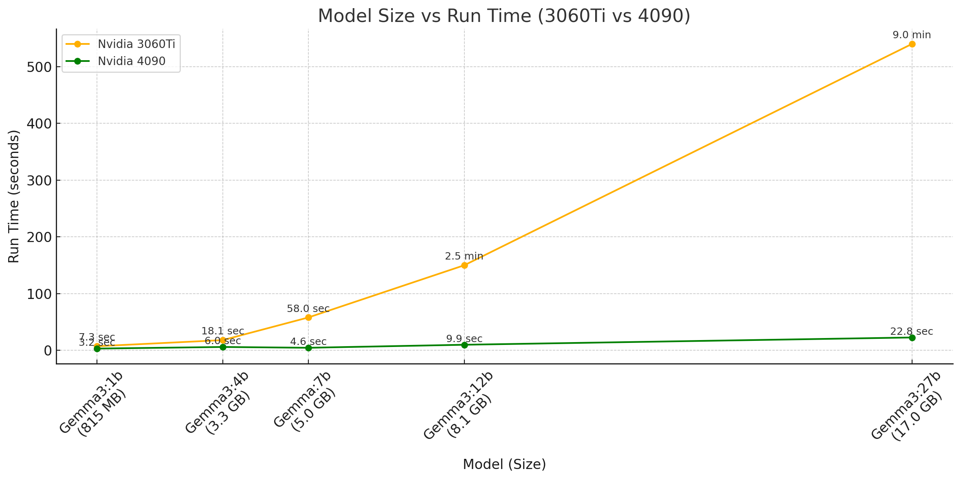
Week 2 assignment – getting started with ai models
Part 3: Running Multiple Models
Use Ollama to download and run at least 4 different models.
Required:
1.gemma:4b
2.llama3.1:8b
Plus any other two models of your choice.
Run the same system prompt + same question for all 4 models. Record:
The response quality.
The runtime (seconds) it takes for each model to answer.
Command: “What is remote sensing?”

Slide 32
Week 2 assignment – getting started with ai models
Part 4: Research Project
Do independent internet research:
Find at least 3 AI models that could be useful in remote sensing tasks (e.g., coding support, hyperspectral imaging, image classification, segmentation).
For each model, write:
Model name.
Who created it.
Whether it is open-source or closed.
Why it could be useful in remote sensing.
Make a presentation next week

